Slide 1
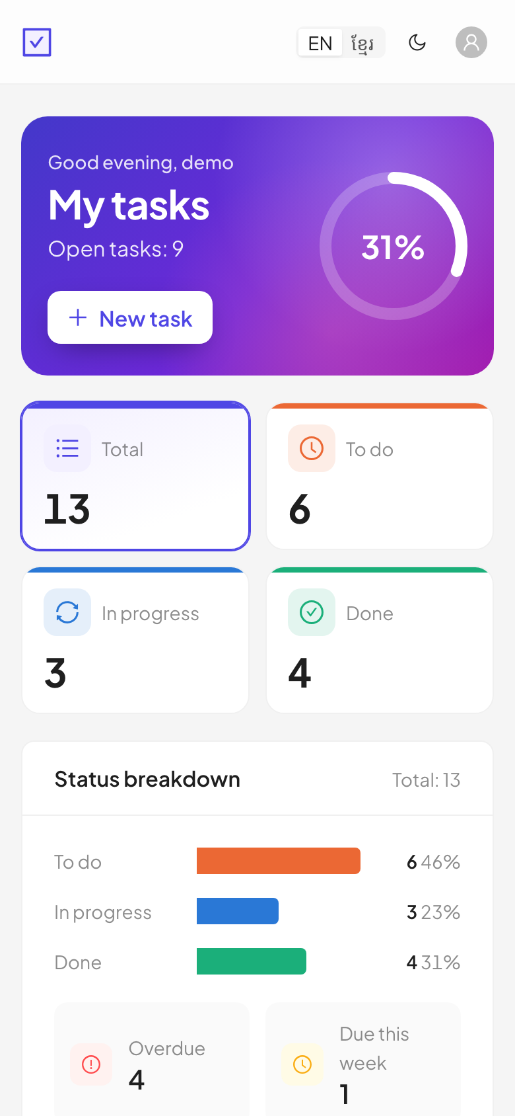
The TaskFlow setup
SHARING SESSION · HOW WE USE AI
The stack, three helpers to level up the UI, and the Claude setup that keeps AI work safe.
React · TypeScript · Vite
Ant Design · Tailwind
DRF · SimpleJWT · PostgreSQL
Claude Code
Notes:
A sharing session, not a class: how the TaskFlow stack fits together, which helpers we used to improve the UI, and how the Claude setup keeps AI-assisted work consistent.

Slide 2

One origin: the browser only talks to Vite
PART 1 · THE STACK
Browser
Vite :5173
Django :8000
Postgres :5433
React SPA, access token in memory
serves the app, proxies /api
DRF + SimpleJWT, /api/v1/
PostgreSQL 17 in Docker
Why one origin? The refresh cookie stays first-party and CSRF works without CORS. In production a reverse proxy serves frontend/dist and forwards /api to Django on one domain.
Source: frontend/vite.config.ts · docker-compose.yml · CLAUDE.md (“served from one origin”)
Notes:
Start every new developer here. scripts/dev.sh starts all three server pieces: Postgres in Docker on host port 5433, Django on 8000 and Vite on 5173. The browser only ever calls localhost:5173, and Vite forwards anything under /api to Django.

Slide 3
React 19 + TypeScript: pages load only when needed
PART 1 · FRONTEND
lazy(): the login page never downloads the task table.
// App.tsx: route-level code splitting
const TasksPage = lazy(() =>
import('./features/tasks/TasksPage')
Typed API: change a serializer, change types.ts in the same commit.
.then((m) => ({ default: m.TasksPage })))
// api/types.ts mirrors the DRF serializer
Feature folders: features/auth, features/tasks, each with pages, components and tests.
export type TaskStatus = 'todo' | 'in_progress' | 'done'
Source: frontend/src/App.tsx · frontend/src/api/types.ts · Lessons 06, 09
Notes:
TypeScript catches the cheap mistakes: a wrong status string, a missing field. The rule that types.ts mirrors the serializers is in the root CLAUDE.md, so Claude follows it too.

Slide 4
Vite: dev server, proxy, build and tests
PART 1 · FRONTEND
Command | Does
npm run dev | :5173 + proxy
npm run build | tsc -b, then bundle
npm test | Vitest (jsdom)
npm run e2e | Playwright
// vite.config.ts
plugins: [react(), tailwindcss()],
server: {
proxy: {
'/api': {
target: process.env.VITE_DEV_API_TARGET
?? 'http://127.0.0.1:8000',
changeOrigin: false,
},
The e2e run points VITE_DEV_API_TARGET at a separate API on :8001.
},
},
Source: frontend/vite.config.ts · frontend/package.json · Lesson 06
Notes:
The build runs the TypeScript compiler first, so a type error fails the build. Vitest reads its config from the same file. Playwright end-to-end tests run against a real API and a separate database through scripts/e2e.sh.

Slide 5
Ant Design + Tailwind: one job each
PART 1 · FRONTEND
Ant Design 6
Tailwind 4
Owns components and colours: forms, tables, modals, tags.
Only layout and spacing: flex, grid, gap, padding.
@import 'tailwindcss/theme.css' layer(theme);
token: { colorPrimary: BRAND_COLOR,
@import 'tailwindcss/utilities.css' layer(utilities);
borderRadius: 8, fontFamily }
index.css: preflight skipped on purpose
ConfigProvider in PreferencesProvider.tsx
Why: Tailwind’s reset (preflight) would fight Ant Design’s base styles. Splitting the jobs avoids two styling systems clashing.
Source: frontend/src/index.css · frontend/src/preferences/PreferencesProvider.tsx · docs/design-system.md
Notes:
Ant Design colours come from theme tokens through theme.useToken(), never raw hex in components. The brand colour and the gradient live in preferences/brand.ts. docs/design-system.md writes all of this down.

Slide 6
Axios: one client, safe tokens
PART 1 · FRONTEND
Access token (5 min) in JS memory. Never in localStorage.
// api/client.ts (shortened): the only Axios instance
export const api = axios.create({
baseURL: '/api/v1', withCredentials: true,
On 401 the interceptor refreshes once and retries the request.
xsrfCookieName: 'csrftoken',
xsrfHeaderName: 'X-CSRFToken',
Shared refresh: parallel calls wait for one refresh. Two would log the user out, because the server rotates tokens.
})
let accessToken: string | null = null // memory only
refreshInFlight ??= api.post('/auth/refresh/', …)
Source: frontend/src/api/client.ts · CLAUDE.md, Auth model · Lesson 07
Notes:
Rule from frontend/CLAUDE.md: every HTTP call goes through src/api/client.ts. Never create another Axios instance, or the token and refresh logic is bypassed.

Slide 7
React Router: guards, safe redirects, URL state
PART 1 · FRONTEND
Route guards
Safe redirect
Filters in the URL
ProtectedRoute sends guests to /login and remembers where they were going. GuestRoute keeps signed-in users out of /login.
from.startsWith('/') &&
/?status=done&search=milk&page=2 survives a reload and can be shared. Bad values are dropped.
!from.startsWith('//')
Blocks open redirects such as //evil.example.
Source: features/auth/RouteGuards.tsx · features/auth/redirect.ts · features/tasks/query.ts · Lessons 09–10
Notes:
The URL is state. If a user can bookmark it or press back, it belongs in the URL, not in component state. query.ts parses and validates the search params both ways.

Slide 8
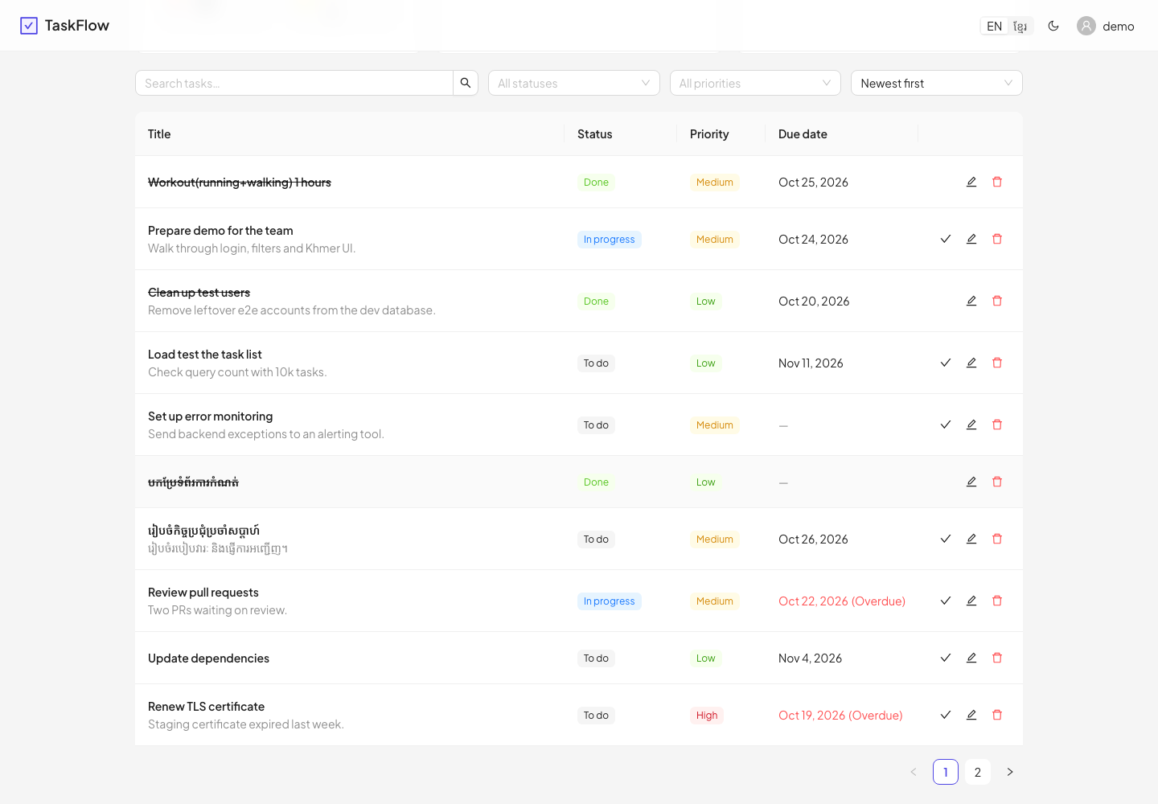
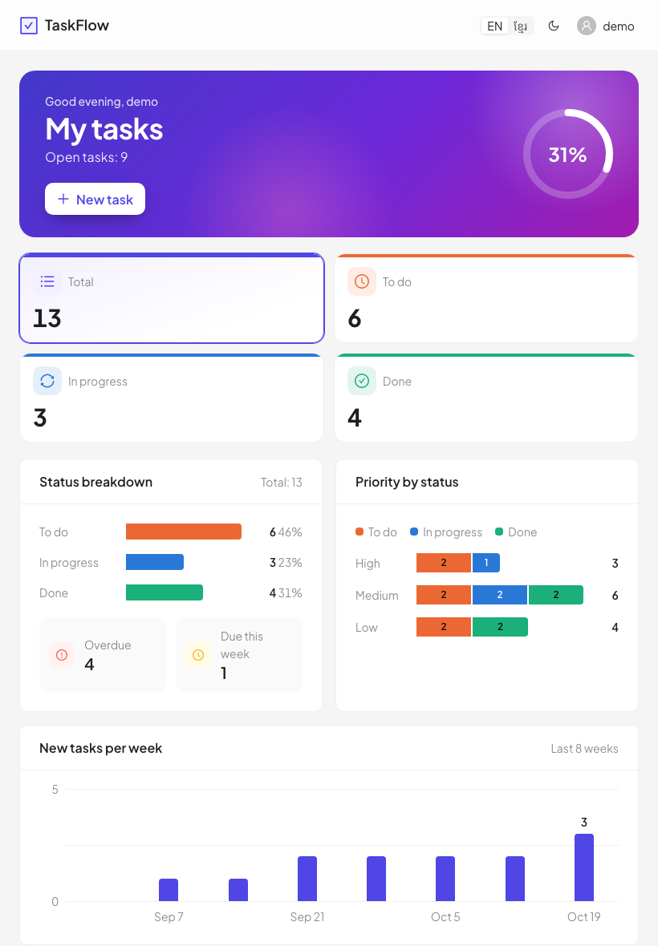
Responsive: desktop, tablet, mobile
PART 1 · FRONTEND
Desktop 1440: table
Tablet 820
Mobile 390: cards
Grid.useBreakpoint() swaps the table for cards below md. Tailwind sm / md / lg / xl classes set the grid columns.
Source: frontend/src/features/tasks/TaskList.tsx:23–26 · Lesson 10
Notes:
Check three widths before calling UI work done: 390, 820 and 1440 pixels, with no horizontal scroll. The Playwright journeys include a mobile test that checks there is no horizontal scroll.

Slide 9
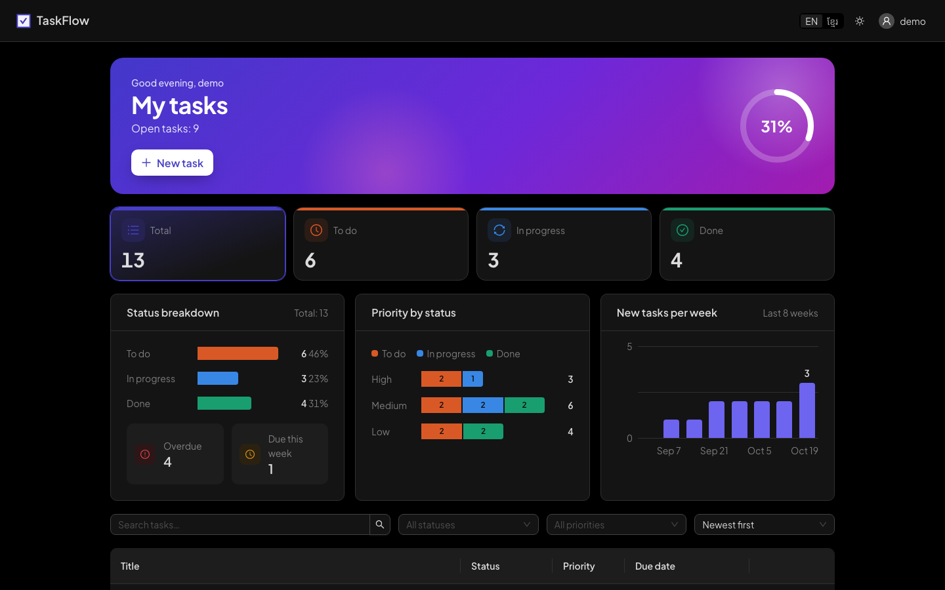
Dark / light mode from one switch
PART 1 · FRONTEND
algorithm: themeMode === 'dark'
? antTheme.darkAlgorithm
: antTheme.defaultAlgorithm
First visit: follows the OS (prefers-color-scheme).
After a click: saved as taskflow.theme. Only preferences go in localStorage, never tokens.
Charts pick their own validated dark colours.
Source: frontend/src/preferences/PreferencesProvider.tsx · preferences/brand.ts · Lesson 08
Notes:
Because every colour comes from Ant Design tokens, switching the algorithm repaints the whole app. Anything with a hard-coded colour would break in dark mode, which is why the design system bans raw hex in components.

Slide 10
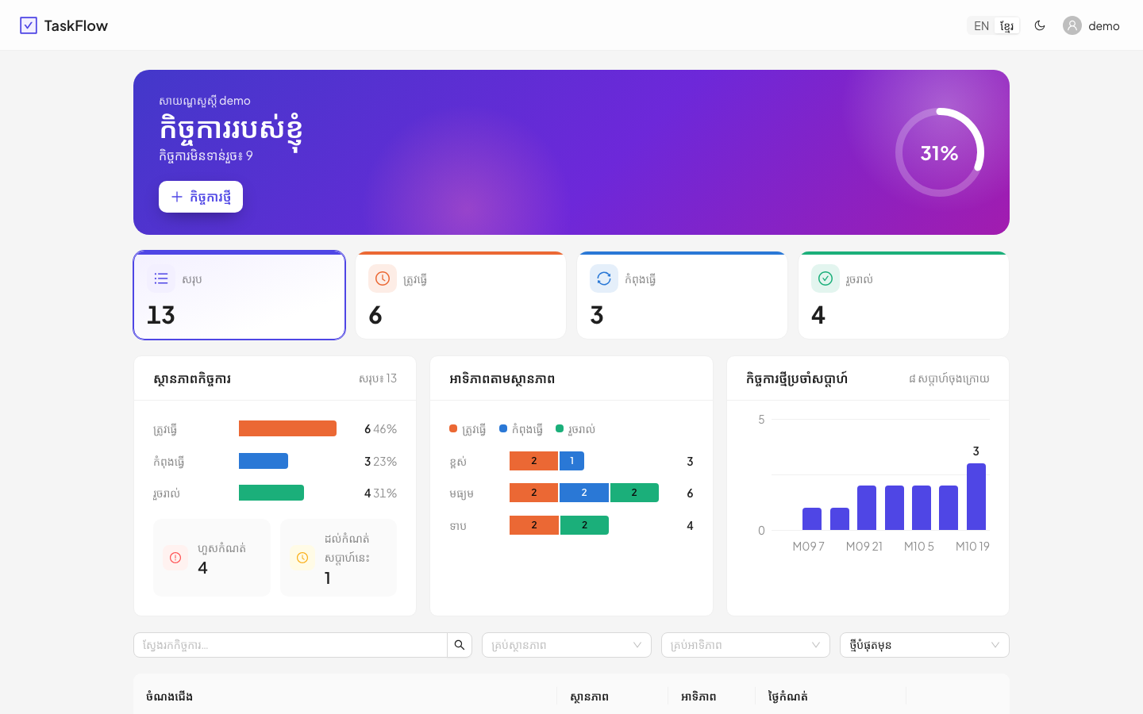
Khmer / English: a missing key fails the build
PART 1 · FRONTEND
// locales/km.ts
const km: TranslationShape = {
app: { name: 'TaskFlow', … },
en.ts is the source of truth. km.ts is typed against it, so tsc fails if a key is missing.
Font: Noto Sans Khmer is bundled; line-height 1.75 for stacked vowels.
Dates: dayjs and Ant Design switch locale too.
Source: frontend/src/i18n/index.ts · i18n/locales/en.ts, km.ts · Lesson 08
Notes:
Look at the chart in the bottom-right of the screenshot: the week labels read “M09 7”. The weekly chart formats dates with the browser’s Intl API, which has no good Khmer short month names. That is a real bug found while making this lesson. A good exercise is to fix it with dayjs, which already has the Khmer locale loaded.

Slide 11
DRF + SimpleJWT + PostgreSQL
PART 1 · BACKEND
Django REST Framework
SimpleJWT
PostgreSQL 17
Task.objects.filter(owner=user)
Access token: 5 min, in memory. Refresh token: 7 days, httpOnly cookie on /api/v1/auth/, rotated and blacklisted on every use. CSRF on refresh and logout.
Docker on :5433. CHECK constraints and owner-first indexes. The ERD and a scaling roadmap are in docs/erd.md.
Every query is scoped to the user. Another user’s task gives 404, not 403, so IDs don’t leak.
Never disable CSRF, permissions, throttling or the ownership filter “to make something work”.
Source: backend/tasks/views.py:29–30 · backend/config/settings.py (SIMPLE_JWT) · docs/erd.md · Lessons 02–05
Notes:
The auth model is marked “do not change without discussion” in CLAUDE.md. Throttles: 10 login attempts and 30 refreshes per minute by default, set from environment variables.

Slide 12
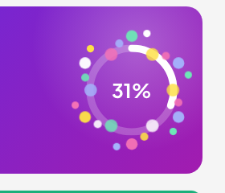
Motion: animation that explains a change
PART 2 · HELPER 1 · MOTION.DEV
# 1. pin a version older than 2 weeks
npm view motion time --json | tail -8
npm install --save-exact motion@14.0.0
# 2. wrap the app once (PreferencesProvider)
<MotionConfig reducedMotion="user">
<LazyMotion features={loadMotionFeatures} strict>
# 3. use the light components everywhere
import * as m from 'motion/react-m'
<m.div initial={{ opacity: 0, y: 12 }}
Animate: things appearing, leaving, a count changing, a task done.
animate={{ opacity: 1, y: 0 }} />
Never: table rows, loops, bounce on data.
Source: frontend/src/lib/motion.ts · PreferencesProvider.tsx · TasksHero.tsx · docs/design-system.md (Motion)
Notes:
Three steps: pin, wrap once, use m components. Timings come from shared tokens in lib/motion.ts. Users who turn on reduced motion in their operating system get instant changes. Tests run with reduced motion on, so numbers show their final value.

Slide 13
An AI design skill: audit, install, ask
PART 2 · HELPER 2 · UI-UX-PRO-MAX
# audit: clone into an empty folder, look for network or shell calls
git clone --depth 1 https://github.com/nextlevelbuilder/ui-ux-pro-max-skill dl/uiux
grep -nE "subprocess|urlopen|requests|os\.system|eval\(" dl/uiux/.claude/skills/ui-ux-pro-max/scripts/*
# installed at .claude/skills/ui-ux-pro-max/ · ask it from the repo root:
python3 .claude/skills/ui-ux-pro-max/scripts/search.py "focus visible keyboard" --domain ux
Kept
Rejected
Guarded
Reduced motion, 1–2 animations per view, no bounce on tables, Plus Jakarta Sans
Its teal palette (brand stays indigo), its GSAP snippets (we use Motion)
A TaskFlow note at the top of SKILL.md: our rules win
Source: .claude/skills/ui-ux-pro-max/SKILL.md (vendored at d14efff, MIT)
Notes:
A skill is instructions and scripts an AI follows on your machine, so treat it like downloaded code. Its search script only reads local CSV files. Claude loads the skill automatically for UI work, or you can type /ui-ux-pro-max. Its results are suggestions; frontend/CLAUDE.md wins on conflict.

Slide 14
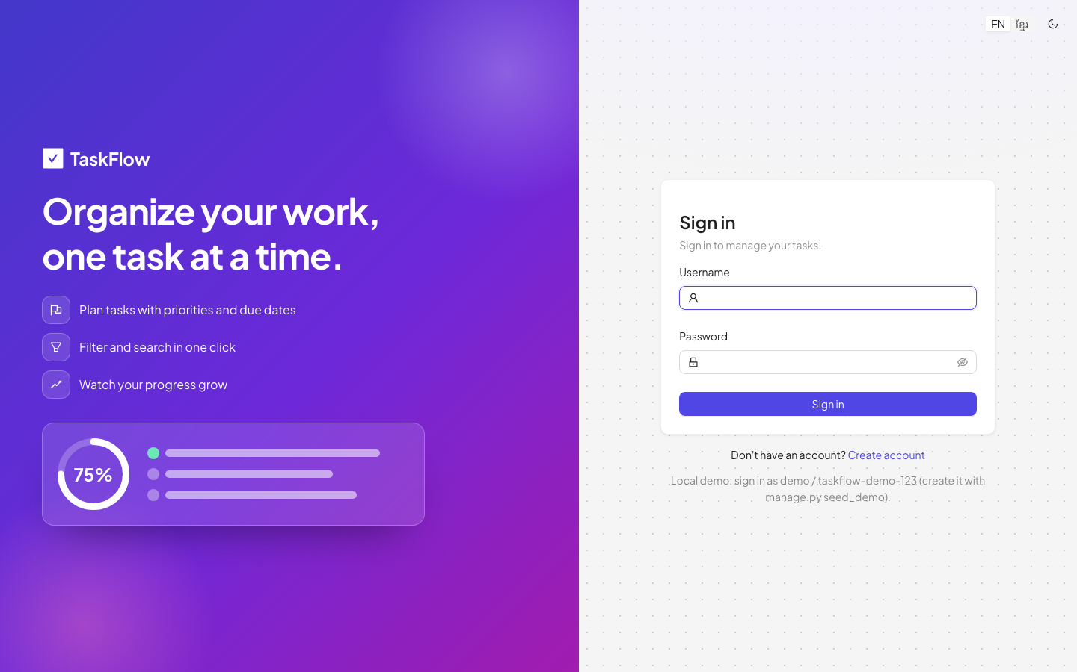
21st.dev: take the idea, not the code
PART 2 · HELPER 3 · 21ST.DEV
21st.dev is a gallery of React components built on shadcn + Radix + Tailwind colours.
Our rule: Ant Design owns components and colours. Pasting its code would add a second styling system.
So: browse for ideas → rebuild with Ant Design tokens. Here: glow + dot grid + split sign-in.
Source: frontend/CLAUDE.md, Conventions · features/auth/AuthLayout.tsx · index.css (.auth-backdrop)
Notes:
When a gallery component uses a different design system, copy the idea: the layout, the effect, the motion. Then build it with what your project already uses. The dot grid here takes its colours from Ant Design tokens, so it works in dark mode too.

Slide 15
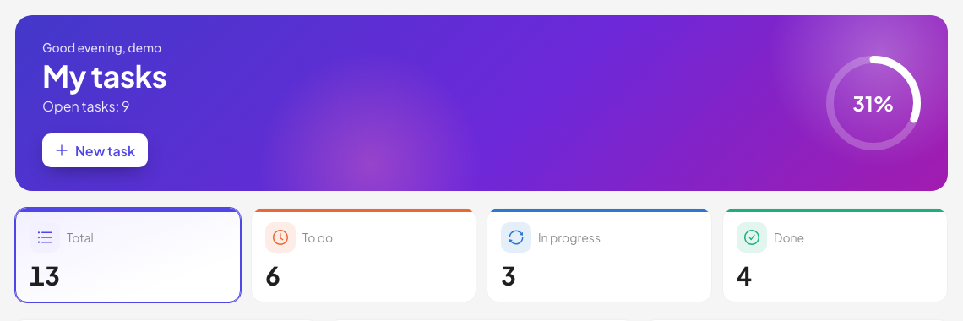
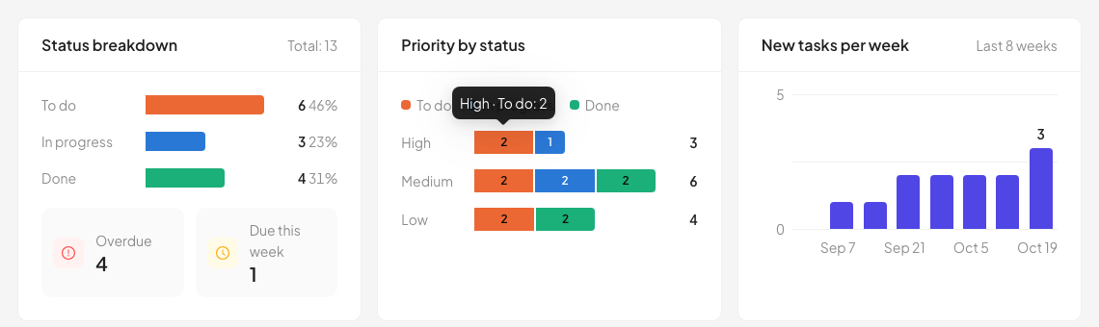
The result, and the rules that keep it
PART 2 · THE RESULT
docs/design-system.md
docs/features/dashboard.md
“Plan first” rule
Colours, type scale, motion, chart rules, a UI checklist
The plan: goal, API, files, tests, open work
In CLAUDE.md: agree the spec before coding
Source: docs/design-system.md · docs/features/dashboard.md · CLAUDE.md
Notes:
Without written rules, helpers like these drift: every new screen picks its own colours and timings. The design system file makes the result repeatable, for people and for Claude. We learned this the hard way: the redesign took three rounds because no target was agreed first.

Slide 16
Everything Claude reads lives in the repo
PART 3 · THE CLAUDE SETUP
Committed to git, so every teammate and every session gets the same setup.
CLAUDE.md rules: whole repo
backend/CLAUDE.md Django rules
frontend/CLAUDE.md React rules
Rules say what to do. Hooks enforce it, even if the AI forgets.
.claude/
commands/ /dev /check /review /commit
skills/ add-api-endpoint, ui-ux-pro-max …
agents/ 2 reviewers + test-writer
hooks/ block-secrets, format-on-edit
settings.json allowed commands + hooks
Source: repo root · .claude/ · Lesson 13
Notes:
Lesson 13 introduced this folder; this slide shows it as it is today, including the ui-ux-pro-max skill. Note the difference between a rule and a hook: a rule is advice the model reads; a hook is a script the harness runs every time.

Slide 17
CLAUDE.md: the rules Claude reads every session
PART 3 · THE CLAUDE SETUP
Cross-package rules
Auth model
Never
Plan first: a spec before multi-file work
types.ts mirrors serializers
erd.md mirrors the models
New logic needs a test
Access token in memory
Refresh in httpOnly cookie, rotated
CSRF on refresh and logout
“Do not change without discussion”
Commit .env or secrets
Tokens in localStorage
Disable CSRF or permissions
Edit an applied migration
Reset the DB unasked
Tip: keep it short and specific. Each package has its own CLAUDE.md with its stack, commands and conventions.
Source: CLAUDE.md · backend/CLAUDE.md · frontend/CLAUDE.md
Notes:
Use /memory to open and edit these files from inside Claude Code, and /init to create a first one in a new repo. When you correct Claude twice about the same thing, that correction belongs in CLAUDE.md.

Slide 18
Built-in slash commands you’ll use daily
PART 3 · BUILT-IN COMMANDS
Command | What it does | Use it when
/copy | Copies the last answer to the clipboard (/copy 2 = the one before) | You need a generated prompt or text
/clear | New conversation, empty context; project memory stays | Starting an unrelated task
/compact | Summarises the conversation to free context | A long task is half-full
/rewind | Goes back to an earlier checkpoint (chat and/or code) | The AI went the wrong way
/model | Switches the model | Cheap model for mechanical work
/context | Shows what is filling the context window | Answers get vague or slow
/memory | Edits CLAUDE.md and memory files | You correct Claude twice
/init · /help | Starter CLAUDE.md · list every command | New repo · you forget a name
Source: code.claude.com/docs/en/commands (checked 2026-10-24)
Notes:
All of these were checked against the official command list on the day this lesson was written. Commands change between versions, so /help is the source of truth on your machine. Other useful ones: /permissions, /resume, /config, /mcp, /hooks, /security-review.

Slide 19
/dev → /check → /review → /commit
PART 3 · OUR PROJECT COMMANDS
/dev
/check
/review
/commit
haiku
haiku
default model
sonnet
Creates .env if missing, starts DB, API and Vite, waits for both URLs
Runs scripts/check.sh, reports PASS / FAIL / NOT RUN. Edits nothing
Diff vs the 3 CLAUDE.md files, violations with file:line. Edits nothing
Message for the staged diff, checks for secrets. Never commits unasked
⚠ Name clash: Claude Code also has a built-in /review (alias of /code-review). Check which one runs with /help.
.claude/commands/check.md
model: haiku
description: Run every backend and frontend check …
Run all project checks … Do not modify any files.
Source: .claude/commands/dev.md, check.md, review.md, commit.md · Lesson 13
Notes:
A project command is just a markdown file: a description, an optional model, then numbered steps and a Never line. Cheap models for mechanical steps, stronger ones where judgment is needed. The /review name clash is real: consider renaming ours to /rules-review.

Slide 20
Skills: step-by-step recipes Claude loads itself
PART 3 · SKILLS
Skill | Starts when you say… | It makes sure
add-api-endpoint | “add an endpoint to archive tasks” | view, test, types, docs
add-task-field | “tasks need an estimate” | migration → UI, en + km
add-i18n-key | “add an Archive button label” | both en.ts and km.ts
backend-tests · frontend-tests | “add tests for this” | tests what users see and do
ui-ux-pro-max | any UI or design work | design rules checklist
.claude/skills/<name>/SKILL.md # description decides when it auto-loads
Auto-loaded from the description, or typed as /name. A command and a skill with the same name both create the same /name.
Source: .claude/skills/*/SKILL.md · code.claude.com/docs/en/skills
Notes:
Commands are things you trigger. Skills are knowledge Claude pulls in when the task matches the description. Write the description as the phrases a person would actually say, so it triggers at the right time.

Slide 21
Agents check the work. Hooks guard it.
PART 3 · AGENTS AND HOOKS
Agents · .claude/agents/
Hooks · settings.json
backend-reviewer: read-only; security, ownership, migrations, tests
Before Edit/Write: block-secrets.sh refuses writes to .env files
frontend-reviewer: read-only; tokens, i18n parity, API client, styling
After Edit/Write: format-on-edit.sh runs ruff on backend Python
test-writer: adds pytest, Vitest or Playwright tests, never changes the code under test
permissions.allow: tests, lint and scripts run without a prompt
Source: .claude/agents/*.md · .claude/settings.json · .claude/hooks/*.sh
Notes:
Ask: “use the backend-reviewer agent on my changes”. Agents run in their own context and report back, so the main conversation stays small. Hooks are not suggestions: the harness runs them on every edit, and a non-zero exit blocks the action.

Slide 22

Rough idea → good prompt → new session
PART 3 · PROMPT HELPERS
1
2
3
/prompt-master
/copy
/clear + paste
Turns “let’s build a slide lesson” into a full prompt with context, rules and stop points
Puts the generated prompt on your clipboard
Fresh context, then paste. The prompt says “plan first, stop for approval”
Why it works: the agent gets everything in turn one, including when to stop and ask.
Source: this lesson was planned this way · Lesson 15 (writing prompts) · /prompt-master is a personal skill in ~/.claude/skills
Notes:
prompt-master is a user-level skill on this machine, not part of the repo. Any good prompt template works the same way: context, task, constraints, done-when, stop conditions. Lesson 15 covers the anatomy in depth.

Slide 23
Same ideas, different file names
PART 3 · OTHER AI TOOLS
Idea | Claude Code | Cursor | GitHub Copilot
Project rules | CLAUDE.md | .cursor/rules/*.mdc | .github/copilot-instructions.md
Rules for some paths | CLAUDE.md per folder | rule set to specific files | .github/instructions/*.instructions.md
Shared standard | reads CLAUDE.md | AGENTS.md | AGENTS.md (or CLAUDE.md)
Saved prompts | .claude/commands, skills | — | /explain · /fix · /tests in chat
Learn the idea once: written rules + reusable prompts + checks. The file names change per tool.
Sources: cursor.com/docs/context/rules · docs.github.com (Copilot custom instructions, cheat sheet) · checked 2026-10-24
Notes:
All rows were checked against each tool’s official docs on the day this lesson was written. A dash means we did not confirm an equivalent. If your team uses several tools, an AGENTS.md file is read by more than one of them.

Slide 24
Commands to remember
PART 4 · WRAP-UP
# daily loop (run from the repo root)
In Claude Code
scripts/dev.sh # DB + API + Vite
/dev · /check · /review · /commit
/copy · /clear · /compact · /rewind
scripts/check.sh # every check
scripts/e2e.sh # Playwright
# before adding a package
Ask first: destructive
npm view <pkg> time --json
seed_demo --reset (deletes demo tasks) · docker compose down -v (deletes the dev DB volume) · git push
npm install --save-exact <pkg>@<ver>
# schema safety
uv run python manage.py makemigrations --check --dry-run
Source: scripts/ · CLAUDE.md (Commands, Never) · docker-compose.yml (pgdata volume)
Notes:
The scripts work from any folder. check.sh keeps going after a failure and ends with RESULT: PASS or FAIL. The destructive commands have real uses, but say what they delete and get a yes before you run them.

Slide 25
Thank you
Write the rules down. CLAUDE.md and a design system make AI output consistent.
Plan first, then build. Agree the target before the AI writes code.
Verify in the real app. Tests pass; screenshots catch the rest.
Questions?
Notes:
Close with the three takeaways, then open for questions. Good prompts to invite: which helper would you try first, and what rule would you add to your own CLAUDE.md?

